Slide 1

GROUP 1
WHO WANTS TO BE A PROGRAMMER?
Calpe, Carl Ryan Kristopher
Castro, John Paul
Ramos, Laurence
Tuazon, Eleazar
BSCS-3A

Slide 2

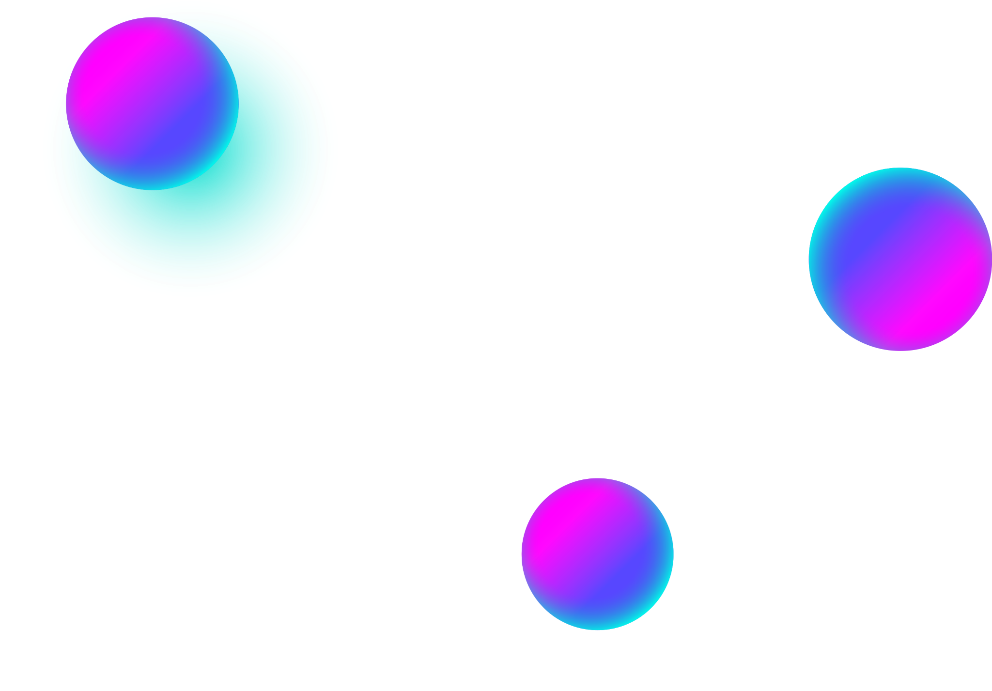
About the Project
We named our game “Who wants to be a Programmer” based on a popular TV gameshow “Who wants to be a Millionaire”.
We used HTML, CSS and JavaScript
Our logo:

Slide 3
Content
Our game has Trivia Questions (all are I.T. related)
It also offers lifelines to players such as 50-50, Call a Friend, and Audience Vote.
Our game also has Easy, Medium, and Hard levels which offers different kinds of difficulty for players to choose from.
The questions are random and has a 30 seconds so players cannot cheat and give better user experience.
It also offers prize pool up to one (1) million PHP (this is not real though)

Slide 4
Thank You!

